Slide 1
2023 Summer Severe Weather Highlights and Possible Ties to ENSO
September 19, 2023
Presenter: Mike Johnson, Science and Operations Officer
Notes:
https://docs.google.com/spreadsheets/d/1xkhqucWshVlFmG78o2vMUqACKS_X_kJmeU1a1AvdiXg/edit#gid=0 https://docs.google.com/spreadsheets/d/1e7eHJLzxMPGu2UZ-yj0LhglLCjueGS2nW87qiD4BthY/edit#gid=0

Slide 2
Agenda
Severe weather statistics
Why is this year so different?
Is this related to El Niño/La Niña?
A look back at summer storms

Slide 3
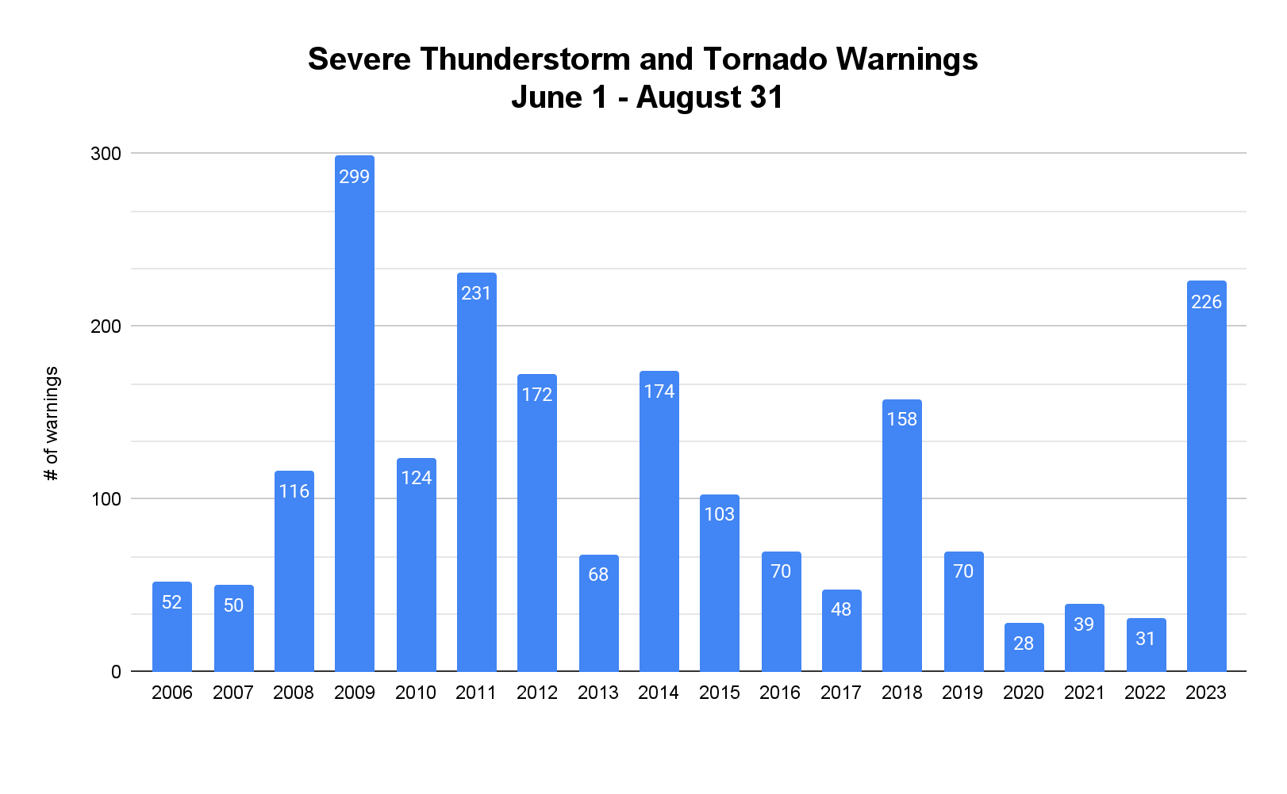
2023 Severe Weather Statistics
June-August 2023 has been one of the busier severe weather summers since 2011
3rd busiest summer since 2006
significantly more warnings than the previous 4 years

Slide 4
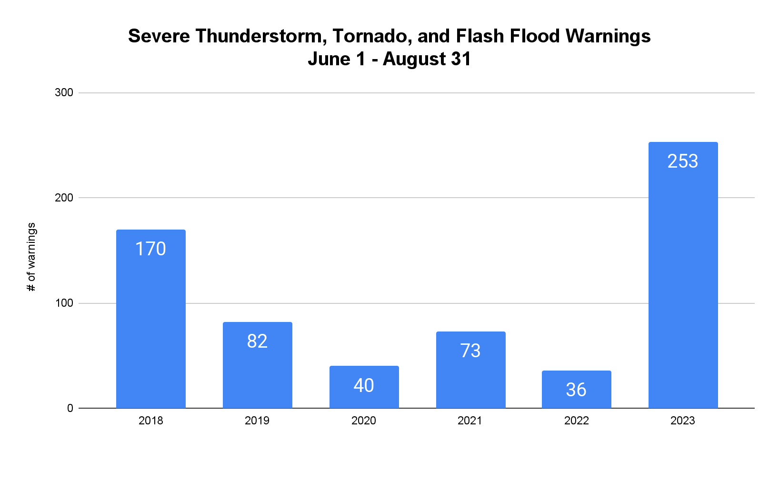
2023 Summer Severe Weather
Total warnings (Tornado, Severe Thunderstorm, and Flash Flood Warnings) for the Memphis County Warning Area are significantly higher than the past few years
Tornado occurrences have been limited during this time period

Slide 5
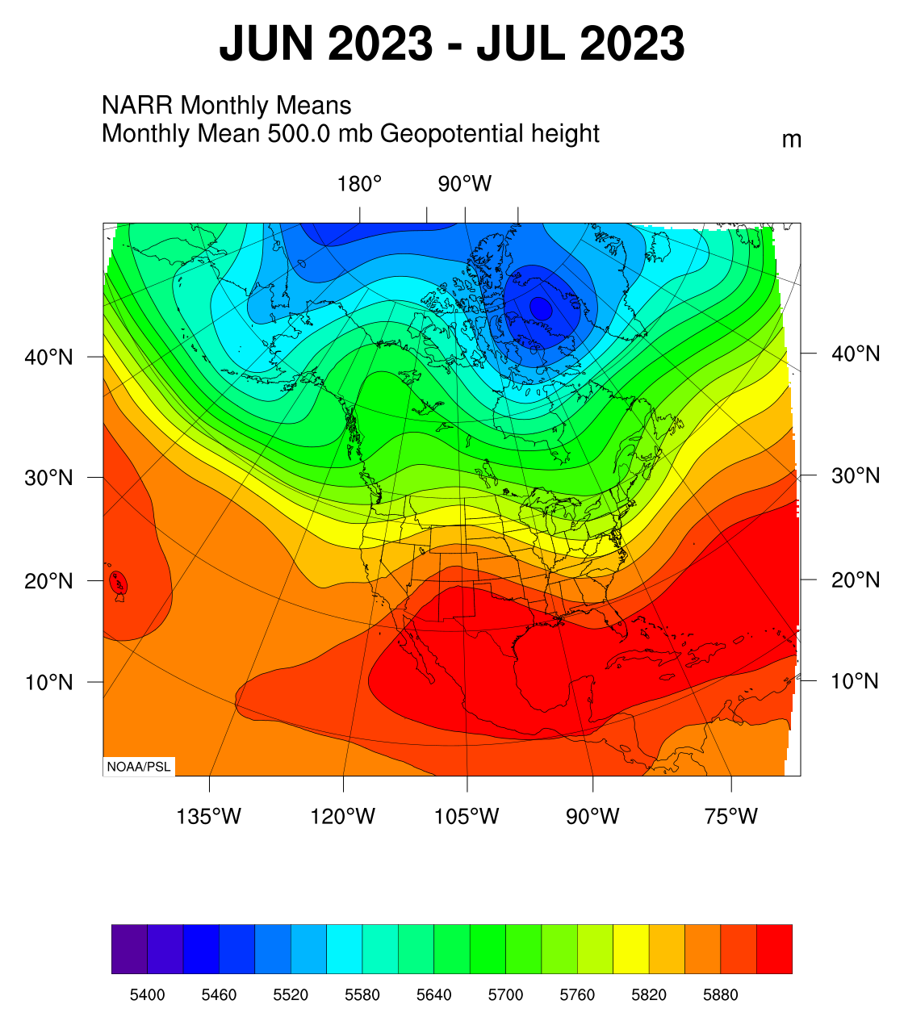
Summer 2023 Upper-Level Pattern
Key features this summer
Prominent upper-level ridge over the Southern Rocky Mountains
Persistent upper-level trough over the eastern United States
Impacts
Slightly below normal temperatures in June and July
Very active storm track for the Mid-South

Slide 6
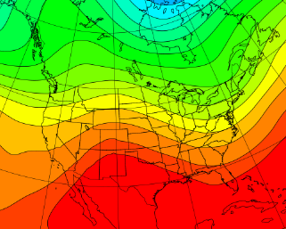
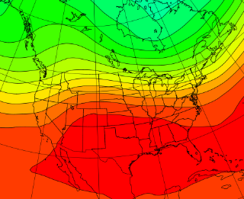
Upper-Level Pattern: 2023 vs 2022
2023 500-mb Heights (Jun-Jul)
2022 500-mb Heights (Jun-Jul)
Cooler
Cooler
H
Hot/Dry
H
Hot/Dry

Slide 7
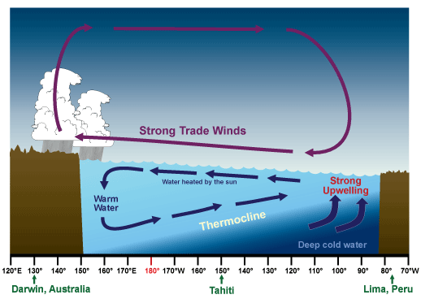
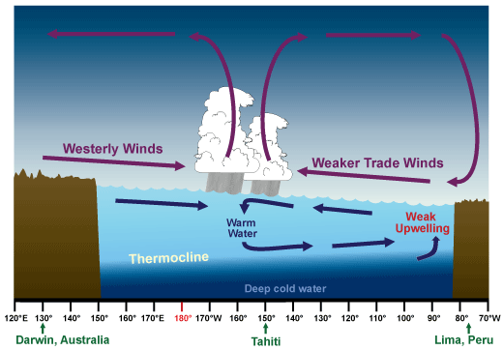
El Niño/La Niña Basics
La Niña episodes are highlighted by stronger than normal, easterly trade winds.
Warmer surface waters are pushed west across the equatorial Pacific allowing strong upwelling off the Peruvian coast
El Niño episodes are the result of weaker than normal, easterly trade winds.
Warmer surface waters develop over the central and eastern equatorial Pacific due resulting in weaker upwelling

Slide 8
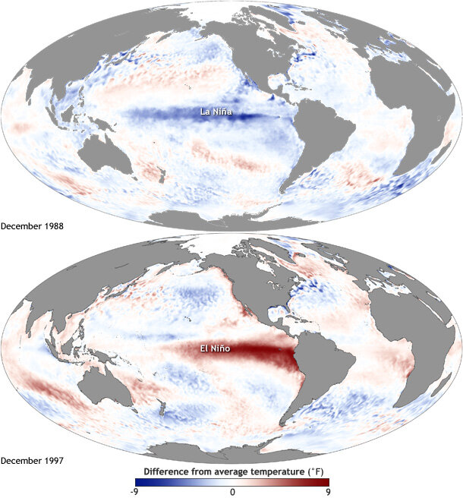
El Niño Southern Oscillation (ENSO)
What are El Niño and La Niña?
These phenomena are climate patterns resulting from sea surface temperature anomalies (difference from normal) over the equatorial Pacific
La Niña is cooler than normal
El Niño is warmer than normal
Notes:
A quick and dirty overview of what ENSO is

Slide 9
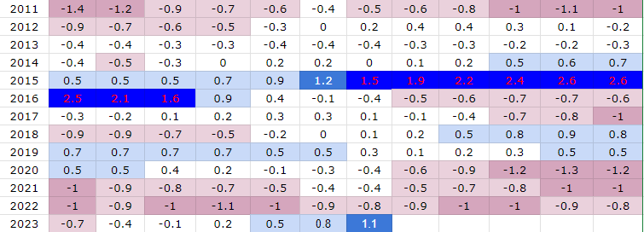
2022-2023 ENSO Pattern
The equatorial Pacific has been cooler than normal since mid 2020 (La Niña), only recently returning above normal (El Niño)
This shift is similar to 2009, 2018, and loosely similar to 2012
The Oceanic Nino Index
Here’s another visualization of that shift since September 2022
Time-averaged sea-surface temperatures in the Niño 3.4 region
Notes:
ENSO changes over recent time periods

Slide 10
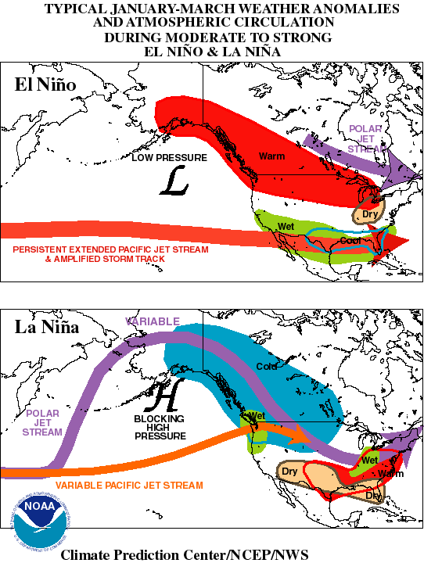
General Weather Patterns Associated with El Niño and La Niña
El Niño tends to lead toward a flatter storm track favoring wetter conditions across the southwest United States and the Gulf Coast
La Niña favors a more amplified pattern with dry weather over the southwest US and Gulf Coast, and a more active storm track across into the Ohio Valley

Slide 11
Comparison to Previous ENSO Events
The 2009 transition from La Niña to El Niño was very similar to the current pattern shift
There are some similarities in the amount of severe weather warnings
However, the sample size is small so confidence in the correlation is low

Slide 12
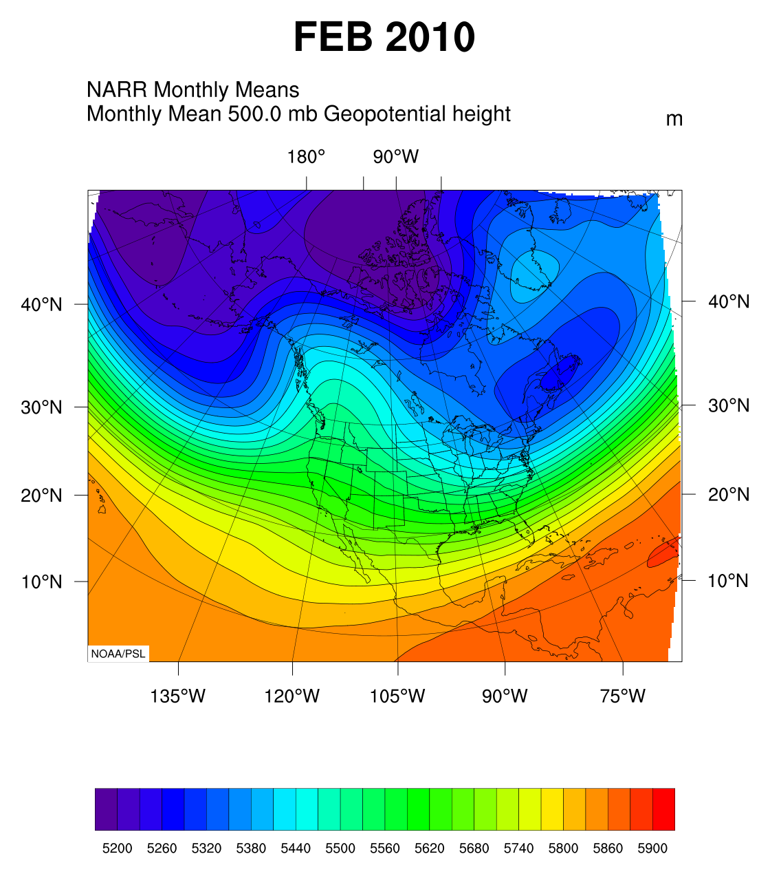
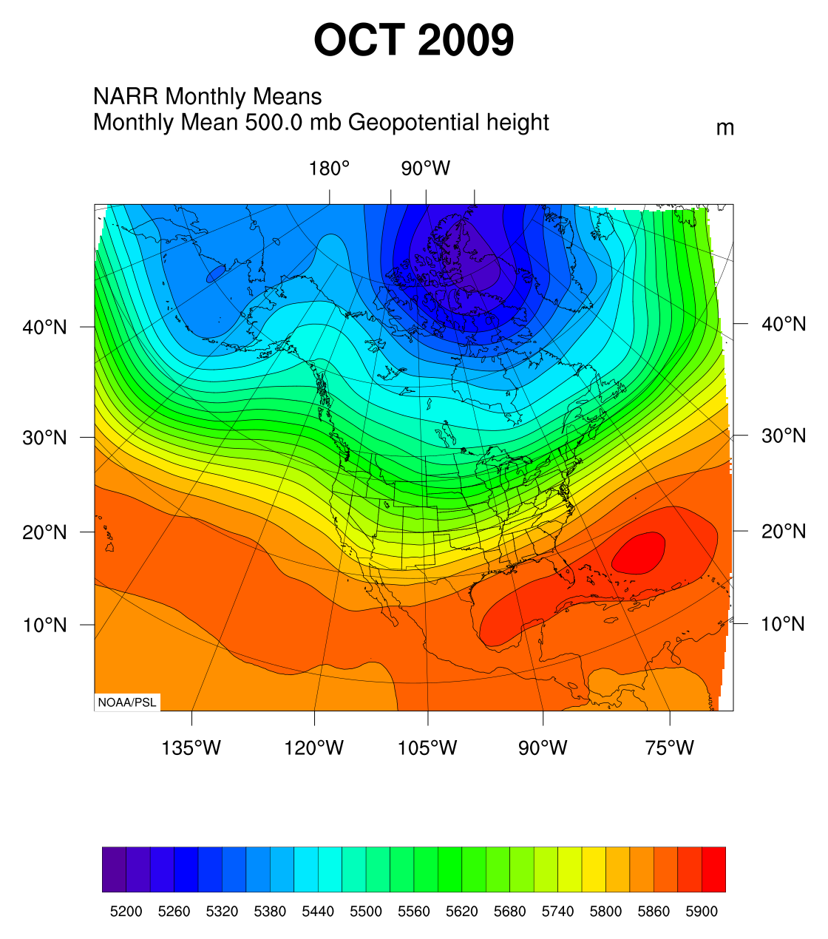
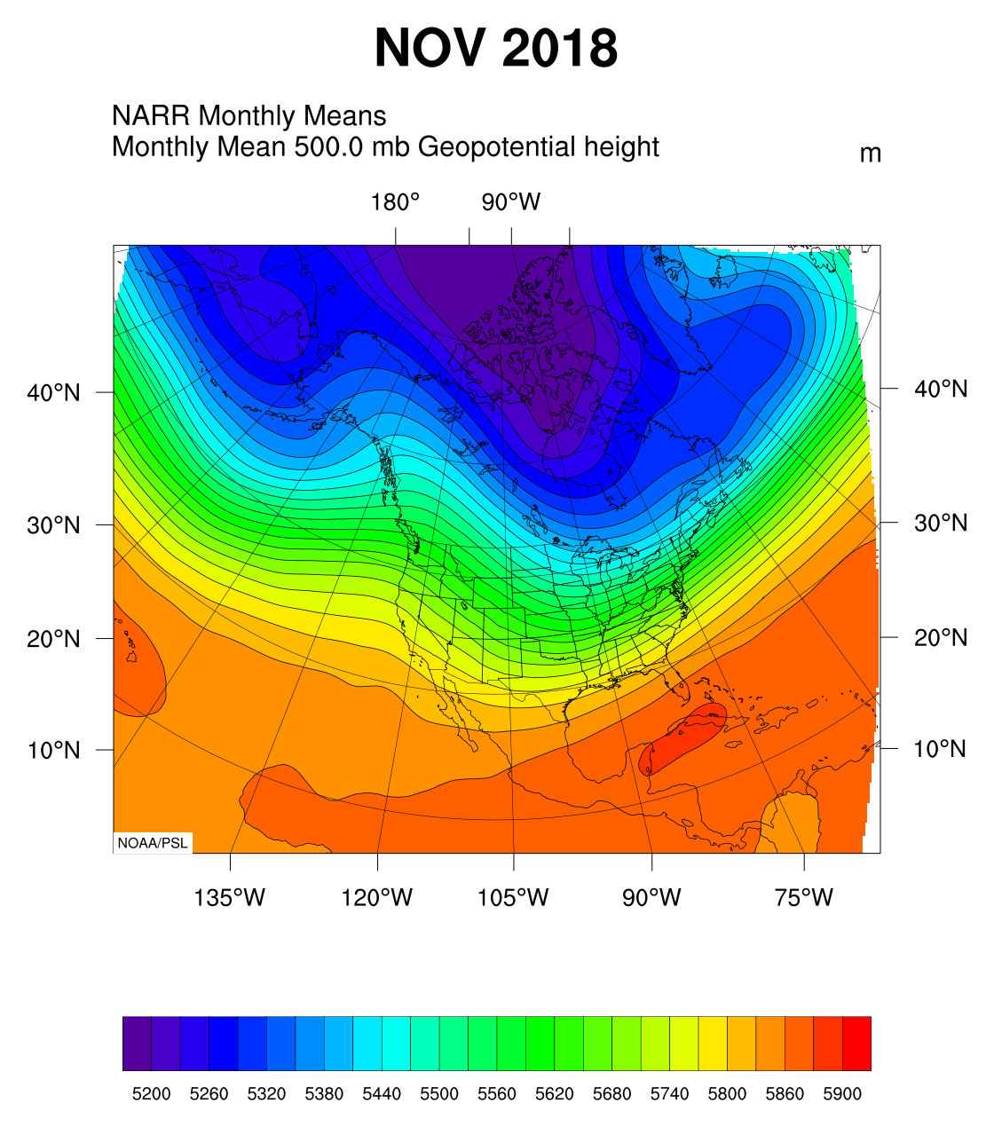
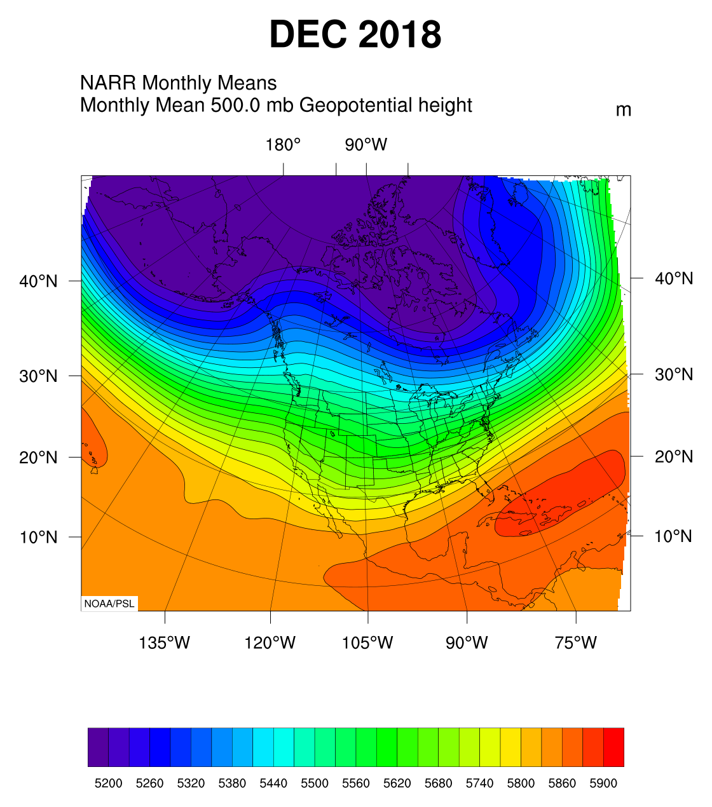
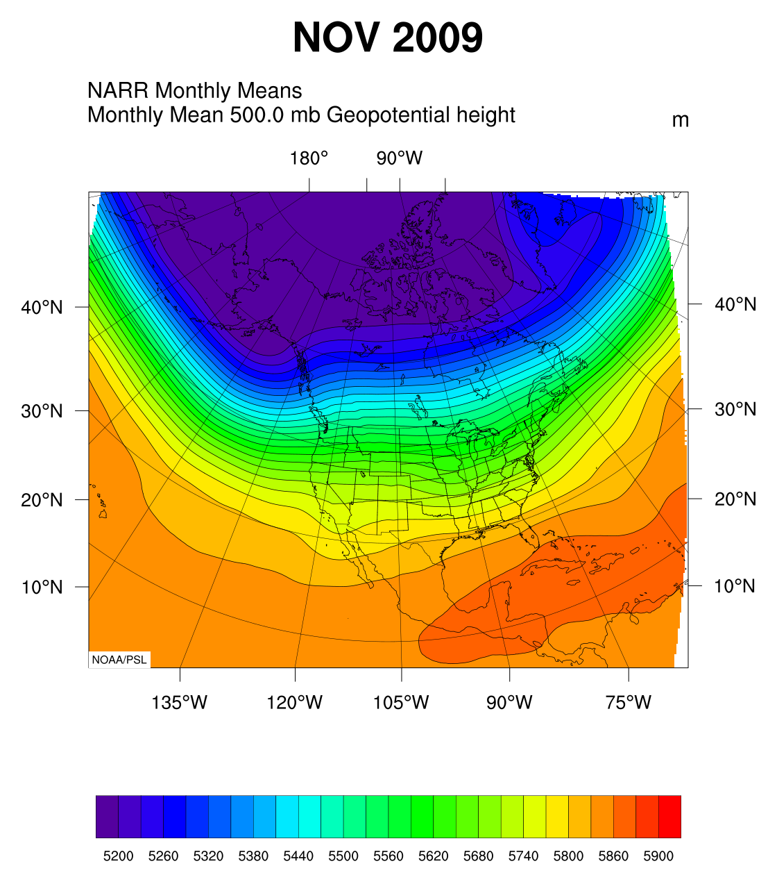
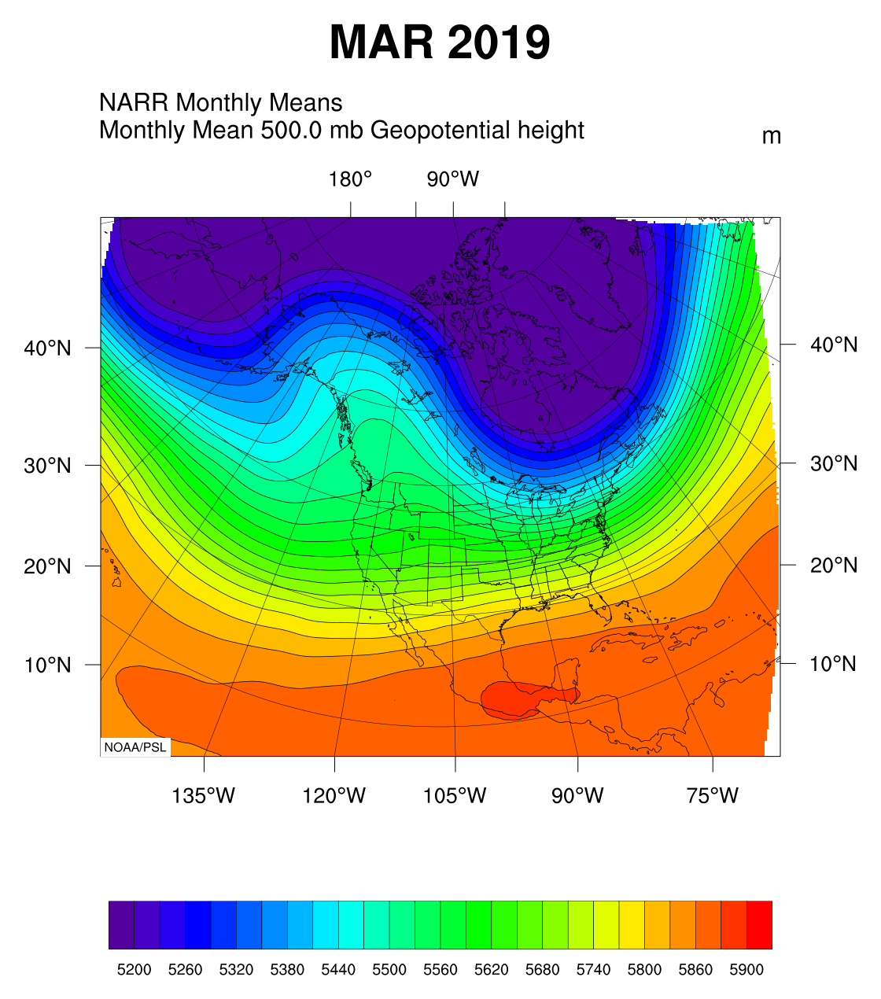
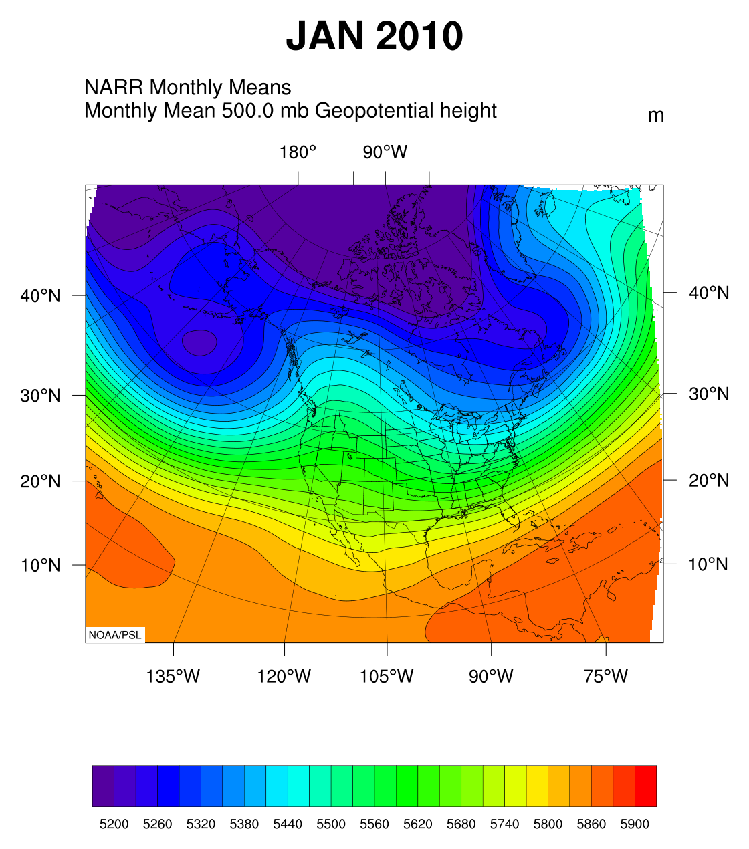
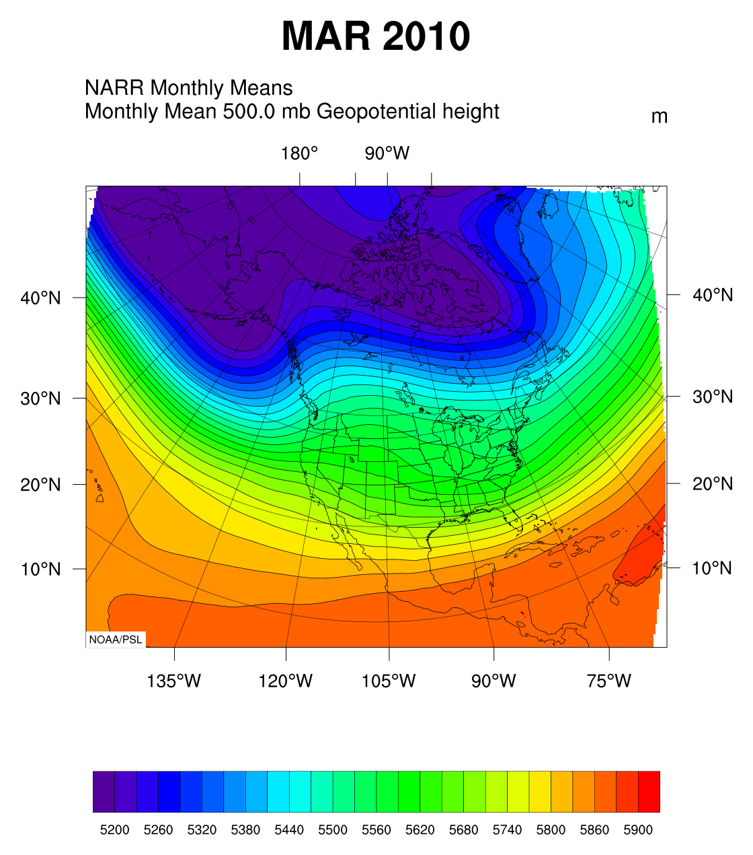
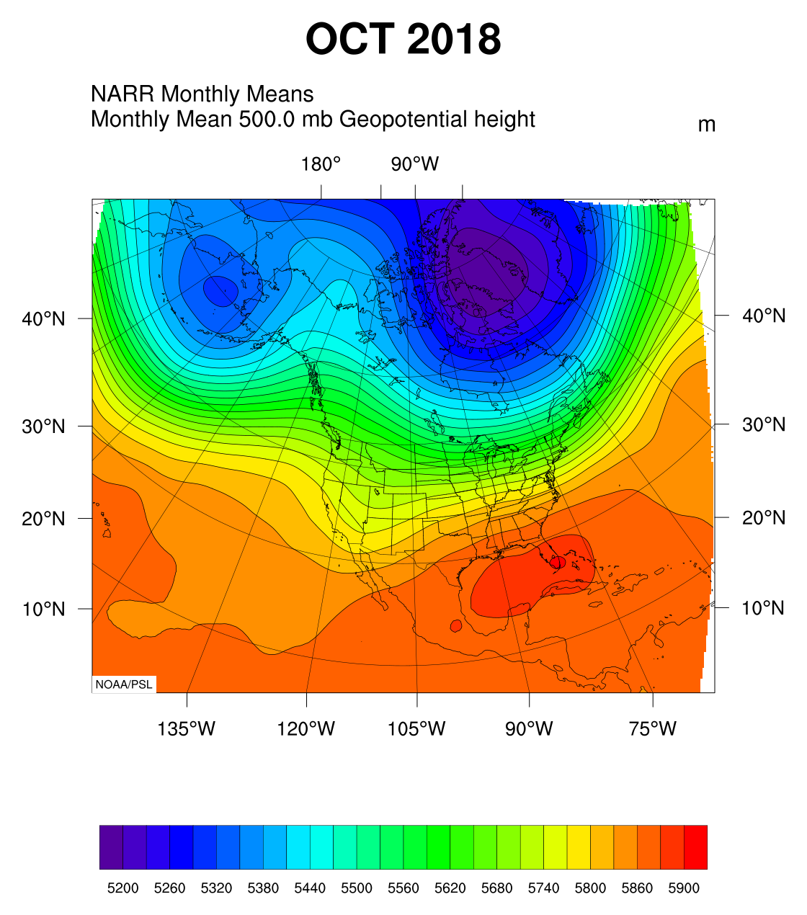
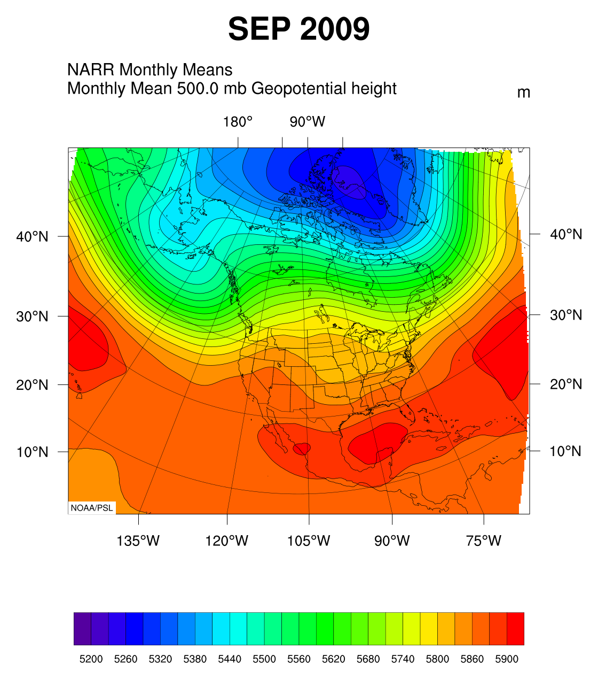
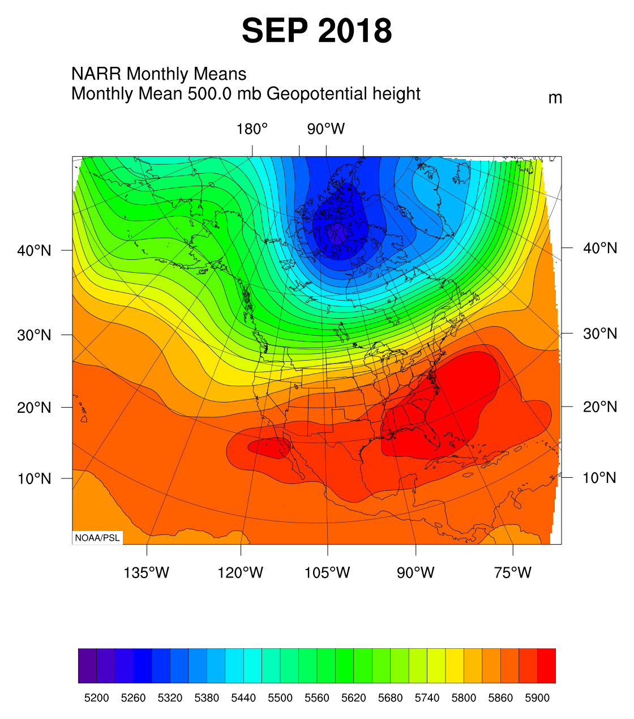
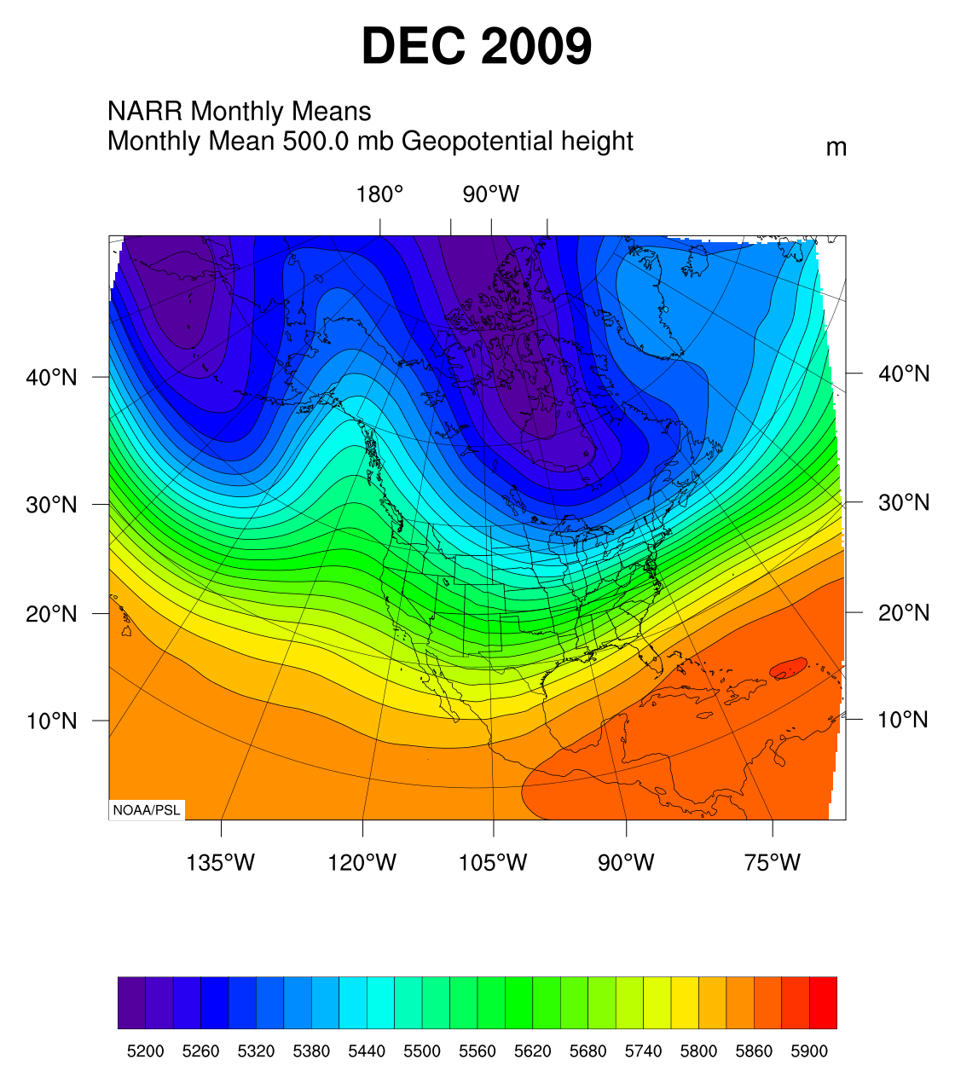
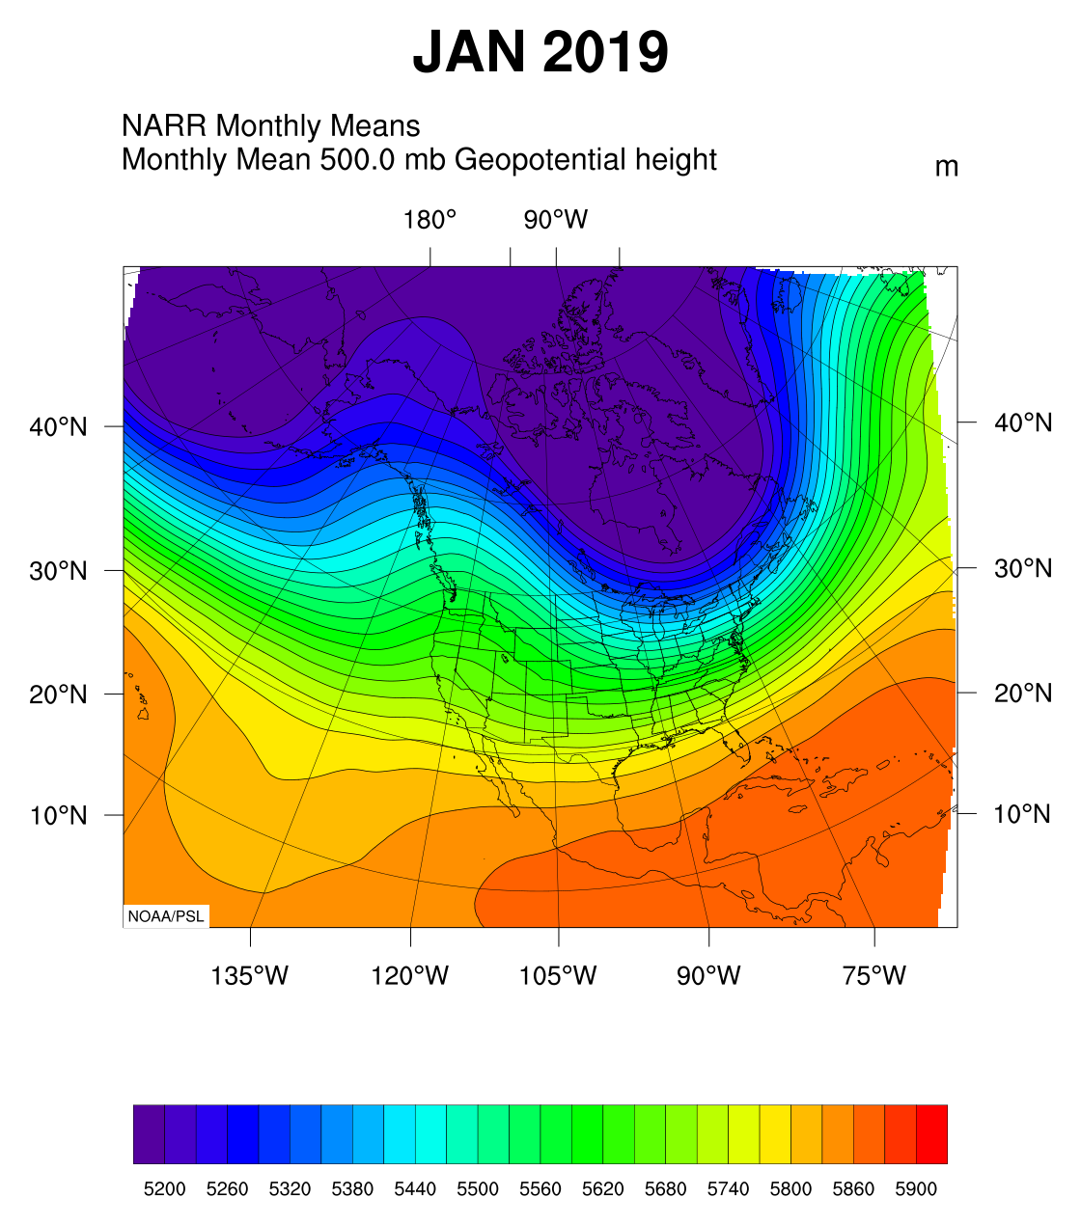
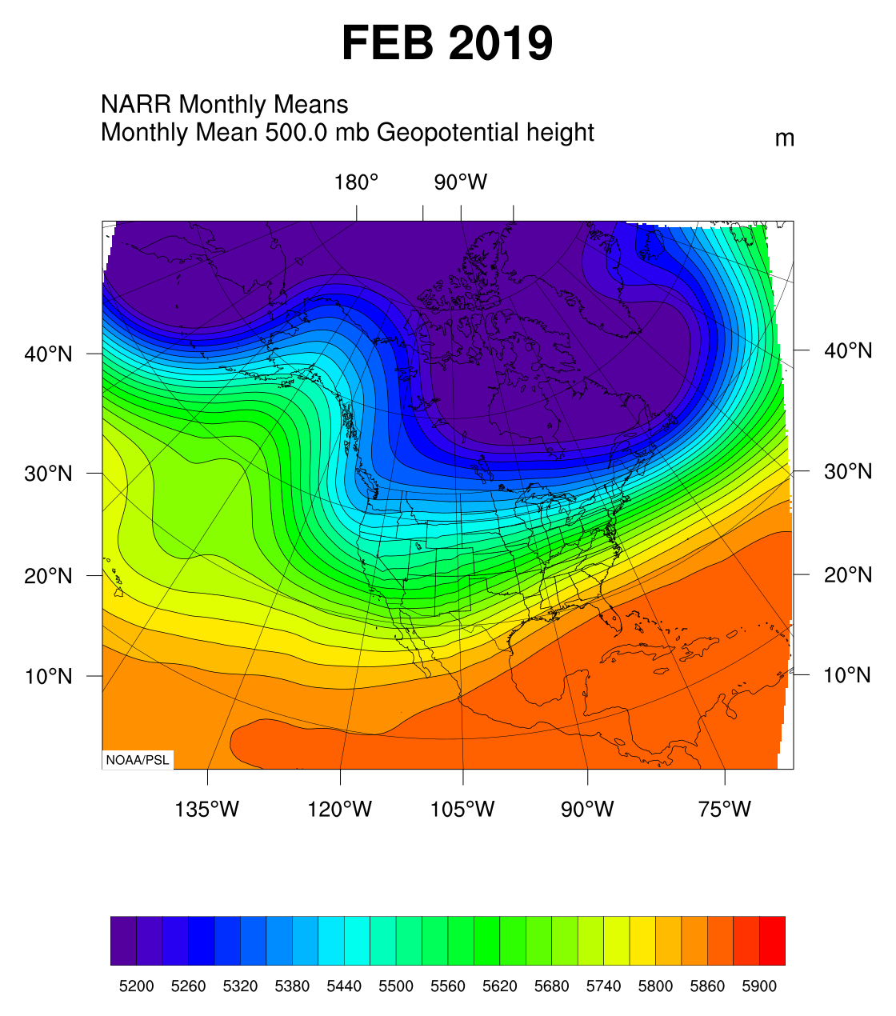

Slide 13
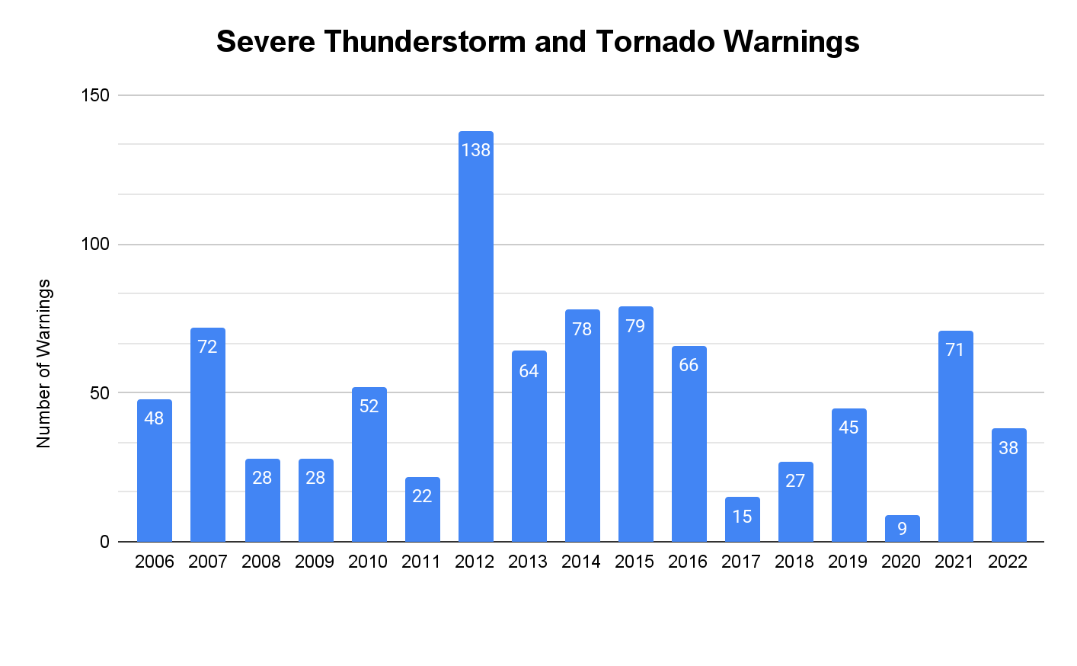
Is the Fall/Winter Pattern Predictable?
We can use similar years as analogs for the upcoming months
There isn’t much of a signal for above normal severe weather in the fall/winter
Aug-Sep warning numbers can be heavily influenced by a single tropical system
Notes:
https://psl.noaa.gov/mddb2/makePlot.html?variableID=116304
Anticipated pattern this fall and winter due to ENSO
Including 2009 analog heights to show changes going into cool season

Slide 14
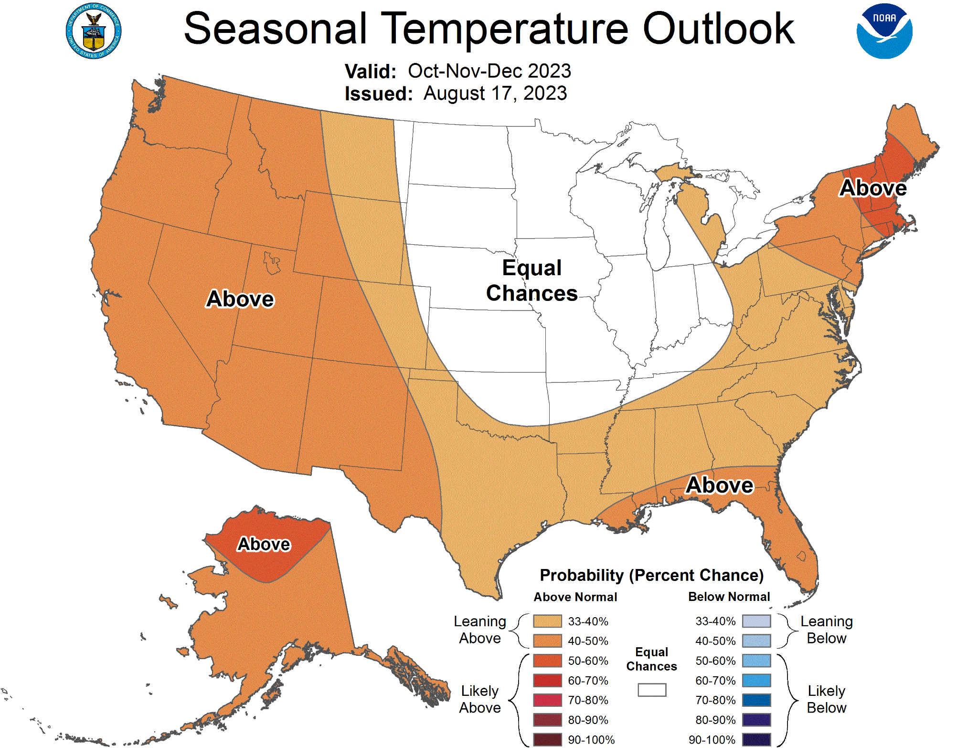
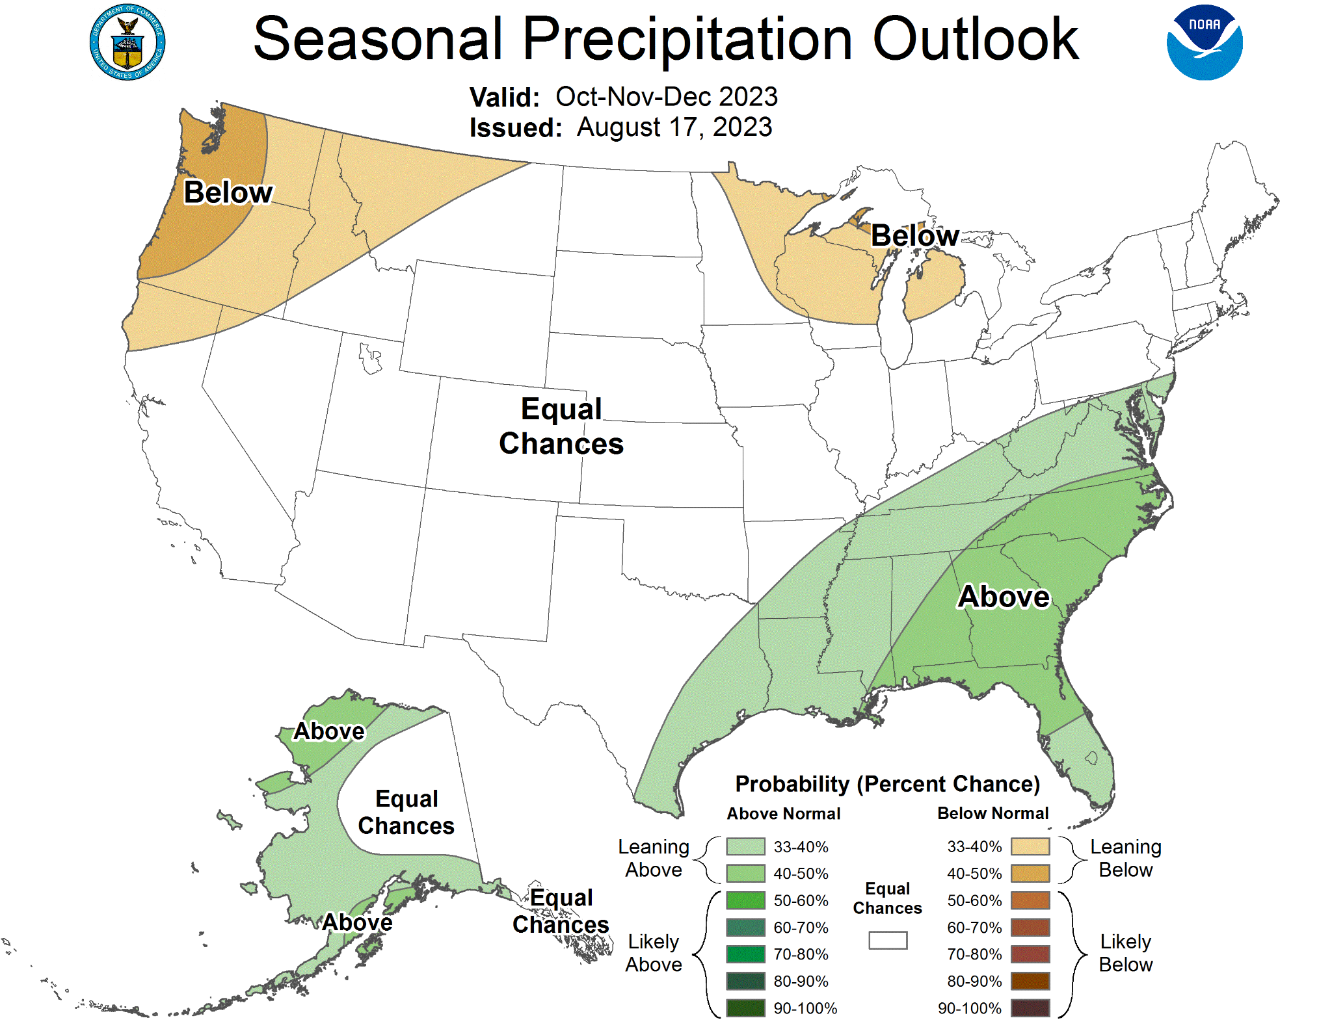
Seasonal Outlooks (Oct-Dec)

Slide 15
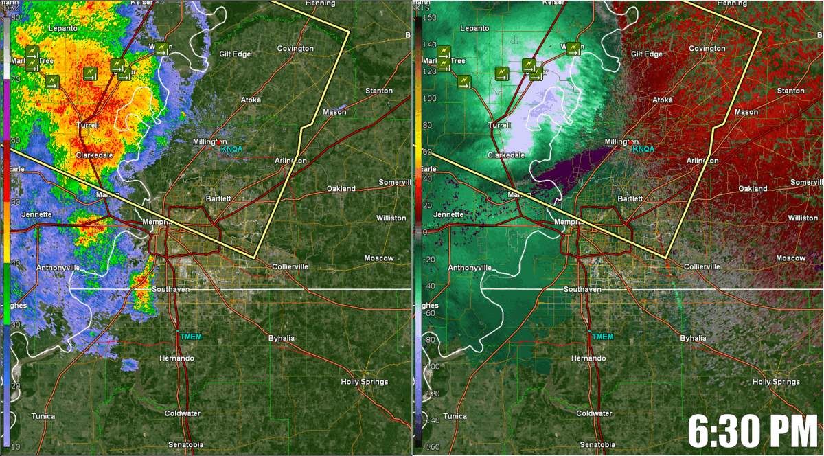
June 25, 2023
Doppler radar was indicating winds exceeding 70 mph crossing the Mississippi River
Damage survey estimated max winds of 80-90 mph across northern Shelby County causing more than 120,000 power outages
Be wary of a shrinking high wind footprint as storm nears radar

Slide 16
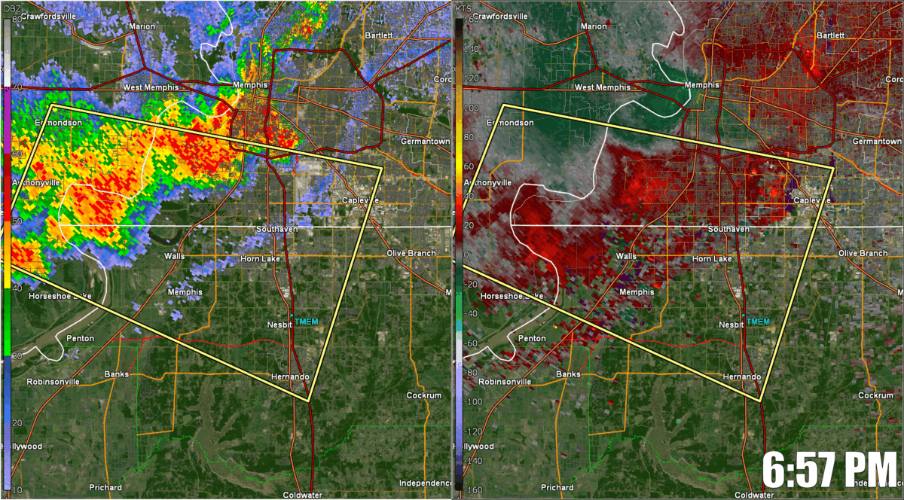
July 5, 2023
tMEM (Memphis Terminal) Radar
KNQA (Millington) Radar
Perspective Matters!
7:12 PM

Slide 17
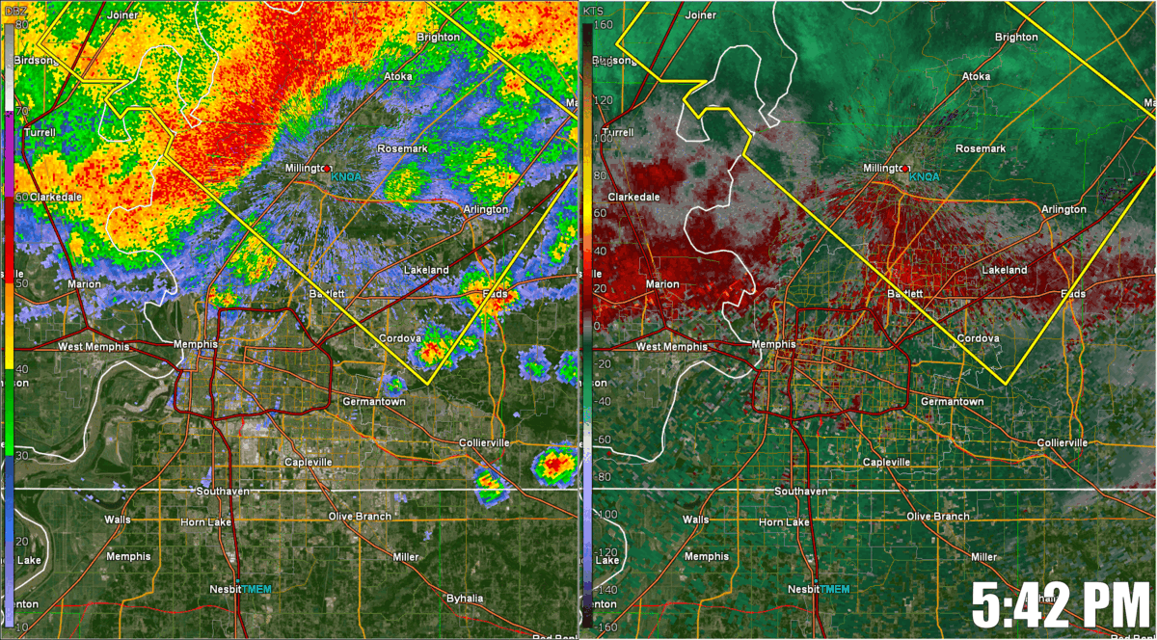
July 18, 2023
Note how quickly the damaging wind swath develops from west of Bartlett to Germantown
More than 130,000 without power

Slide 18
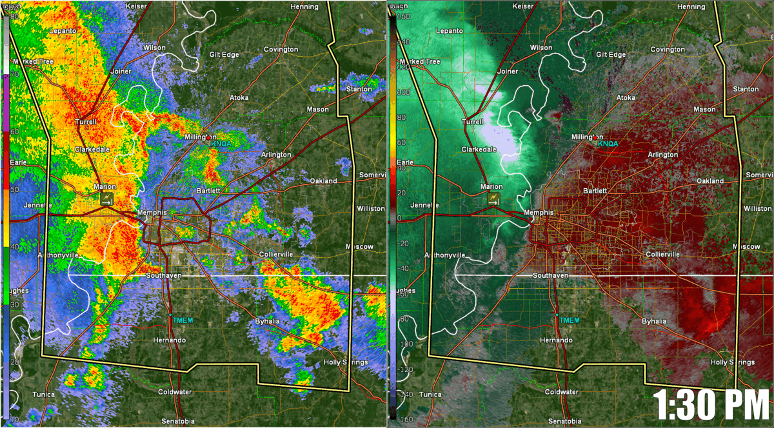
July 21, 2023
Bowing segment intensifying as it moves across Shelby County
Still very difficult to detect damaging wind south of Interstate 40.
Additional 60,000 power outages

Slide 19
Questions
?

Slide 20
Thank you!

Slide 21
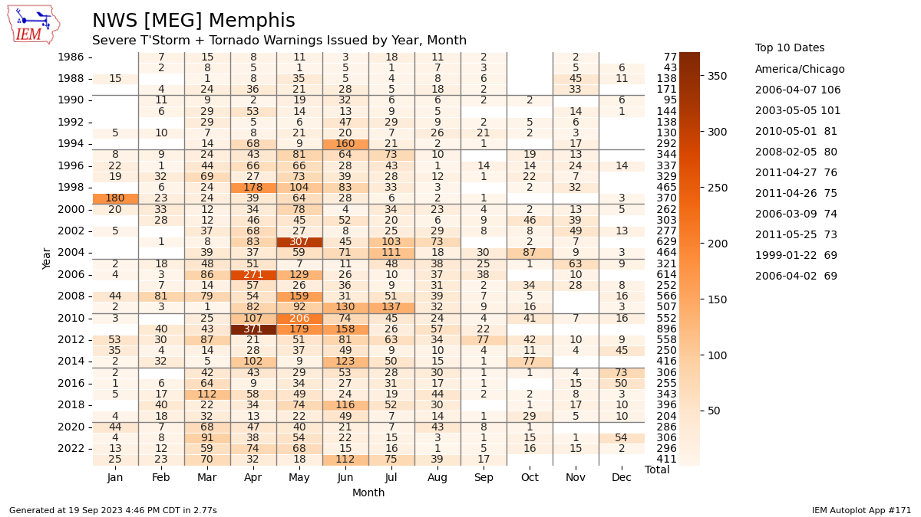
Notes:
https://mesonet.agron.iastate.edu/plotting/auto/?_wait=no&q=171&opt=wfo&station=MEG&state=IA&_ugc_state=IA&ugc=IAC169&c=svrtor&phenomena=SV&significance=W&cmap=Oranges&_r=t&dpi=100&_fmt=png

